Slide 1


Autoencoders for Inverse Problems
Emma Hart
Emory University Department of Mathematics
Joint work with Julianne Chung and Matthias Chung
Third Joint SIAM/CAIMS Annual Meetings
July 28, 2025

Slide 2
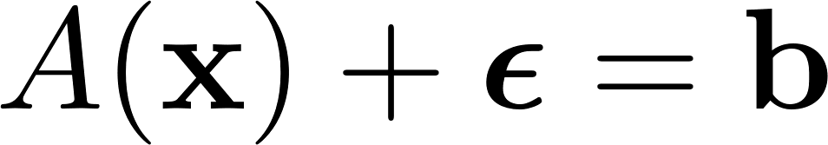

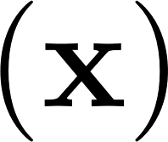




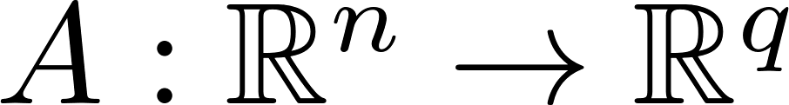
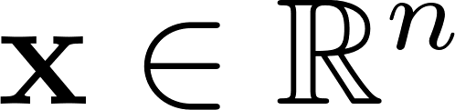

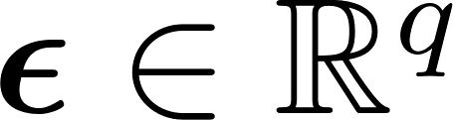



Inverse Problems
Forward process
Parameters of interest
Additive Noise
Observations
Aim to reconstruct x from b and knowledge of A
Computed Tomography

Slide 3













Inverse Problems
Linear
Computed Tomography
Randomized Shepp-Logan Phantoms, Parallel Tomography

Slide 4
Challenges
Computational Costs
  High dimensional problems have millions of unknowns and observations
  Forward models are often expensive to evaluate, and inversion often requires many forward and adjoint solves
Ill-posedness
  Solutions may exist, may not be unique, and/or may not depend continuously on input data
Regularization
  Requires finding balance between data fidelity and prior information
Uncertainty quantification
  UQ is critical to decision making, but computationally expensive

Slide 5
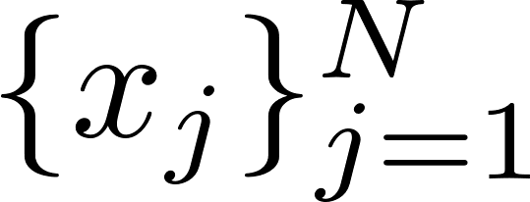
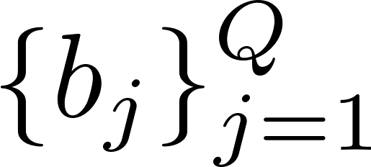
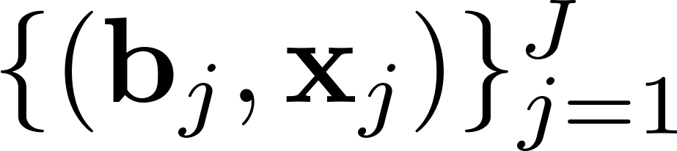
Machine Learning Approaches
Learn from some available parameter/observation data
To Create a Full Inversion Surrogate
  Kulkarni et al. 2016, Wu et al. 2020
To Regularize
  Afkham et al. 2021, Li et al. 2020
Uncertainty quantification
  Goh et al. 2019, Lan et al. 2022
Surveys: Arridge et al. 2019, Bai et al. 2020, Lucas et al. 2018

Slide 6
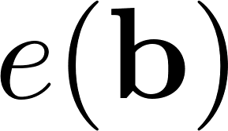

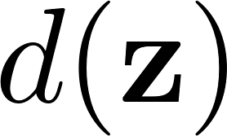
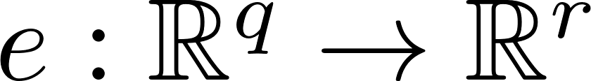
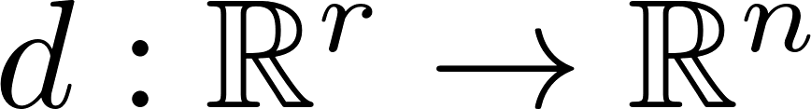
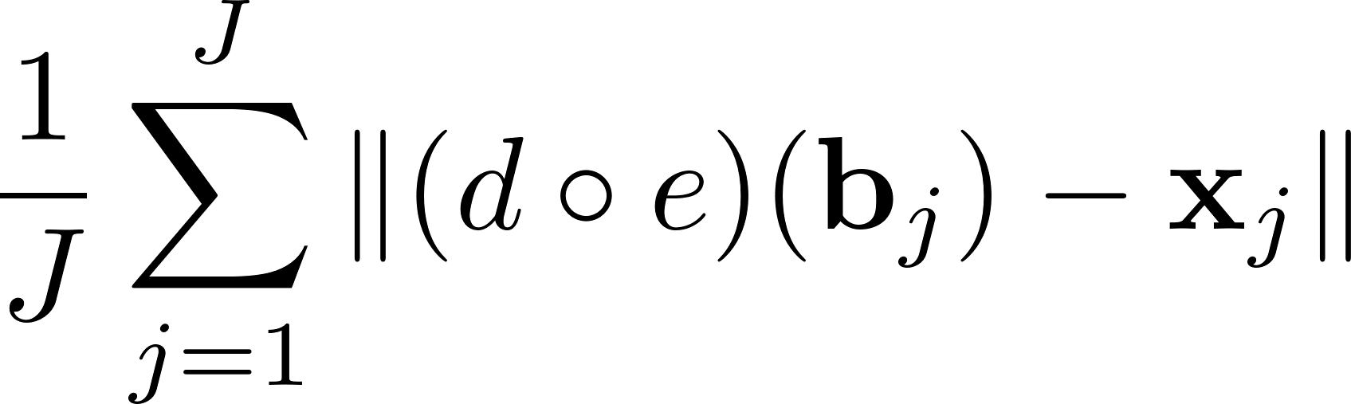
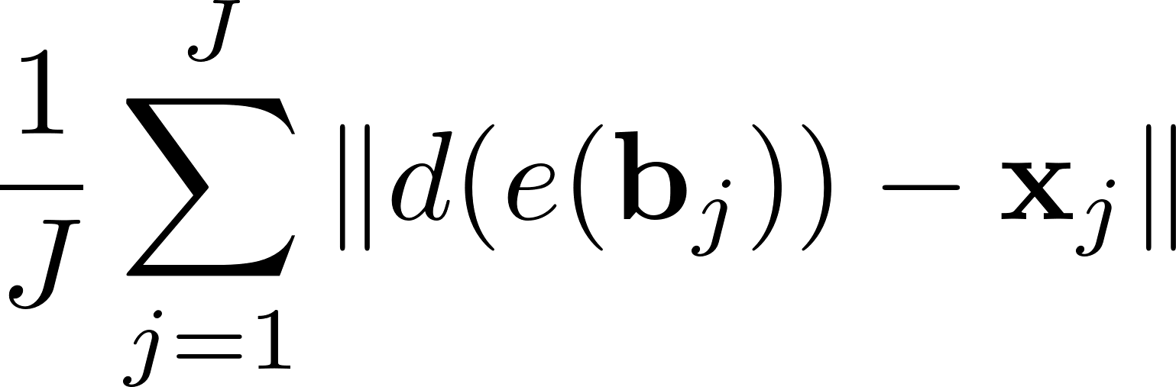
Encoder-Decoder Networks
Popular network architecture in a variety of machine learning tasks
Learn parameters for e and d to minimize for
Supervised learning

Slide 7
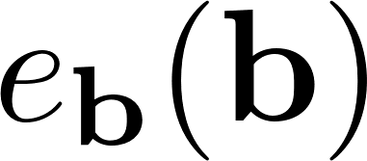

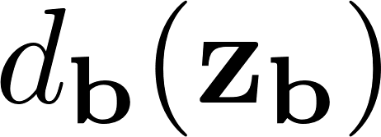
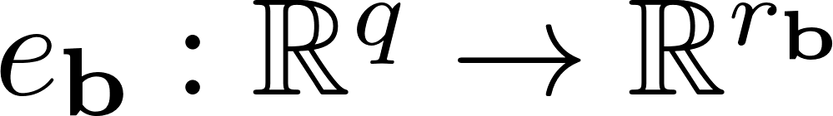
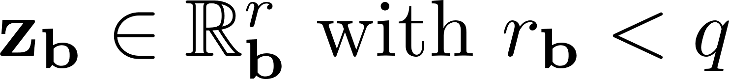
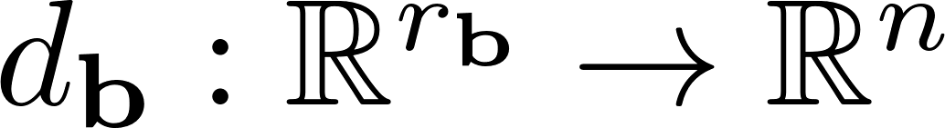
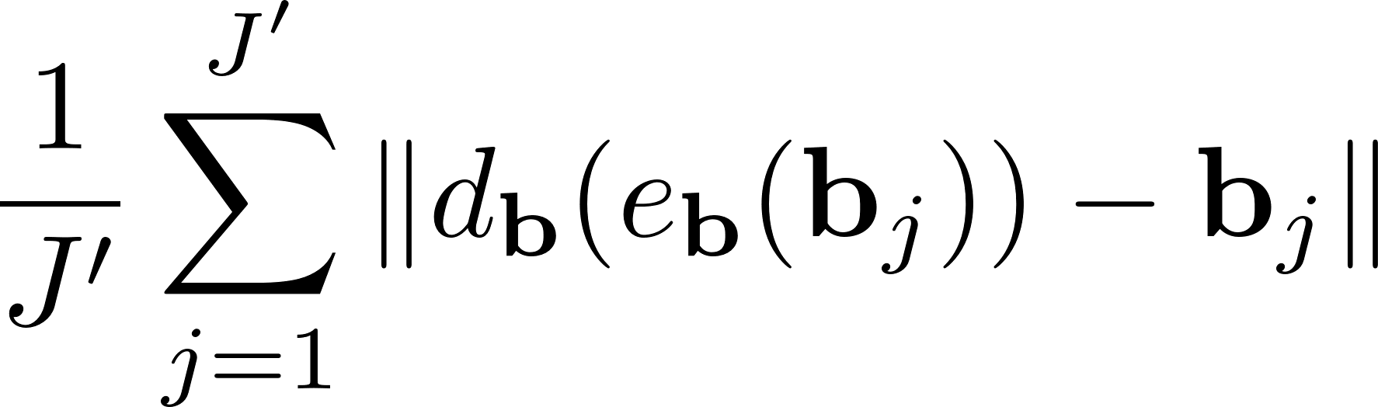
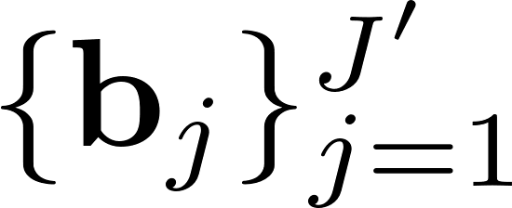
Autoencoders
One kind of encoder-decoder, often used in dimensionality reduction and denoising applications
Learn parameters for e_{b} and d_{b} to minimize for
Self-supervised learning

Slide 8
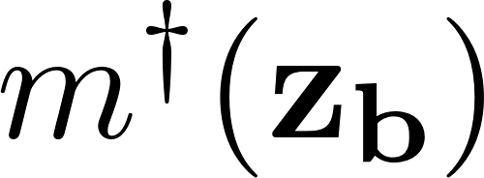
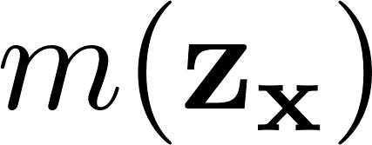
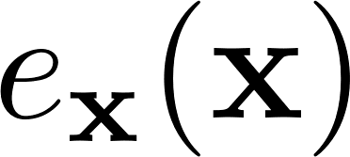

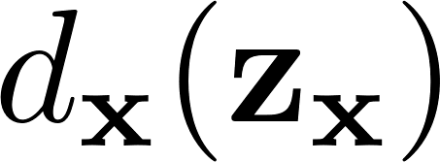
Paired Autoencoders for Inference and Regularization (PAIR)
Key Ideas:
Use self-supervised learning to create one autoencoder for inputs, b
Use self-supervised learning to create another for targets, x
Use supervised learning to find inverse and forward mappings between latent spaces
Inverse Surrogate:
Forward Surrogate:
Works with similar paired structures:
Zheng et al. 2015, Feng et al. 2023, Boink et al. 2020

Slide 9
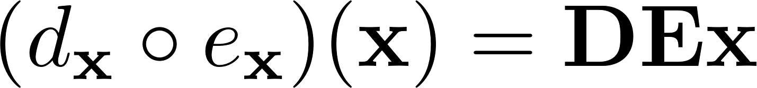


Theory for Linear Autoencoders
Consider a linear encoder
and linear decoder
then define a linear autoencoder

Slide 10
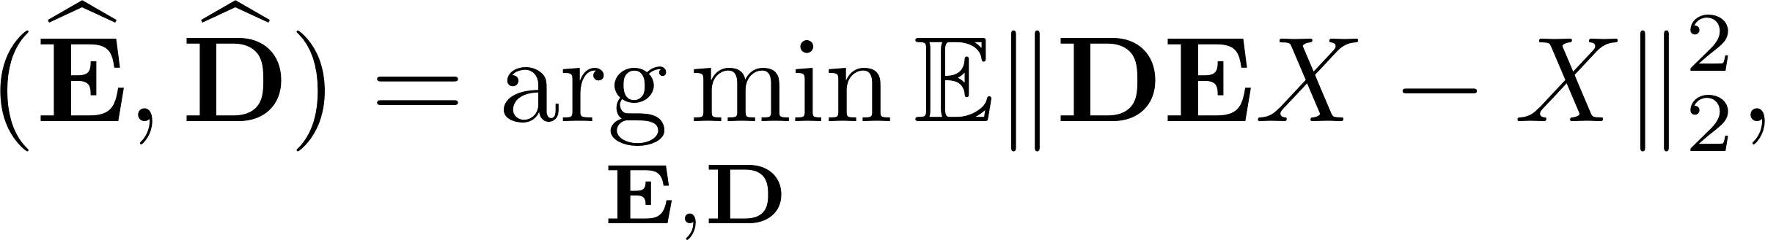
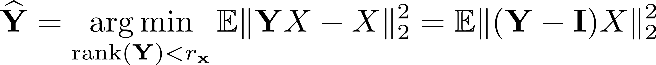
Bayes Risk Minimization
Let X be a random variable with a given probability distribution. An optimal linear autoencoder is given by
which simplifies to

Slide 11
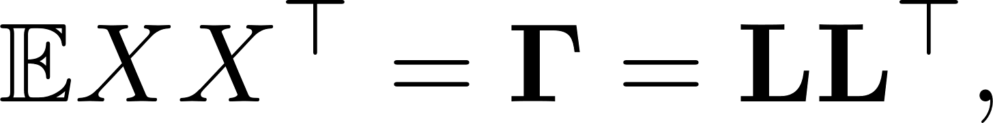
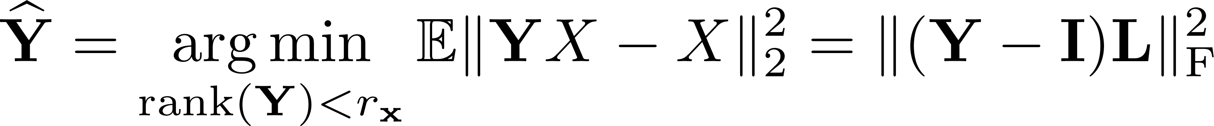
Bayes Risk Minimization
Given that X has symmetric positive definite second moment
then we can reformulate the optimization problem

Slide 12
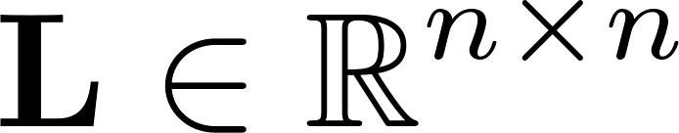
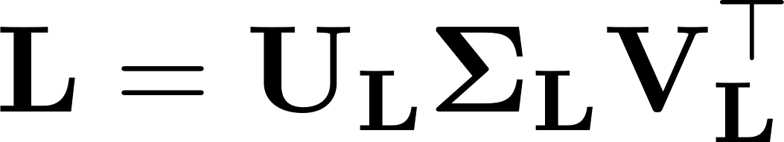
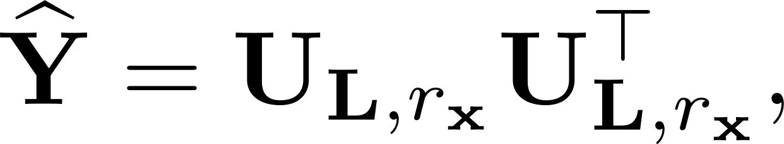
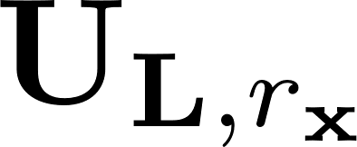

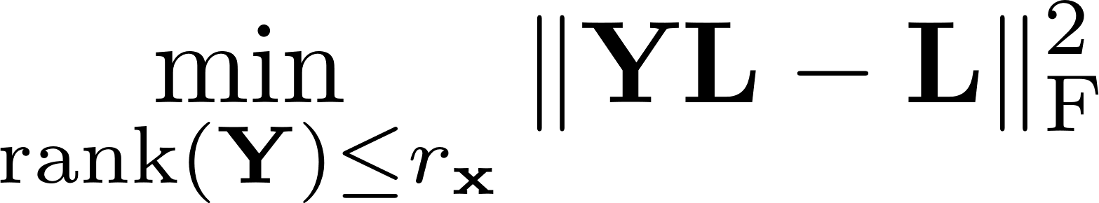
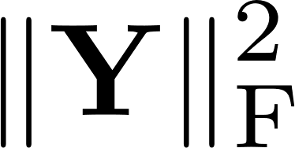
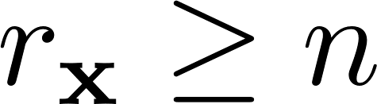
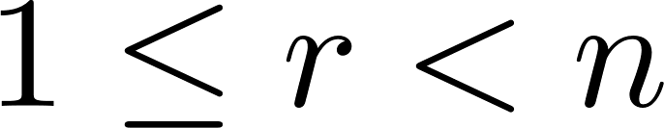
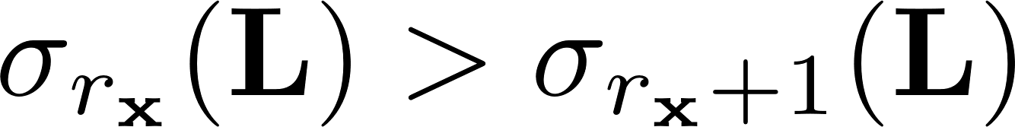
Bayes Risk Minimization
Let matrix have full rank with SVD given by .
Then,
where contains the first r_{x} columns of orthogonal matrix , is a solution to the minimization problem
having minimal . This solution is unique if and only if either or and .

Slide 13
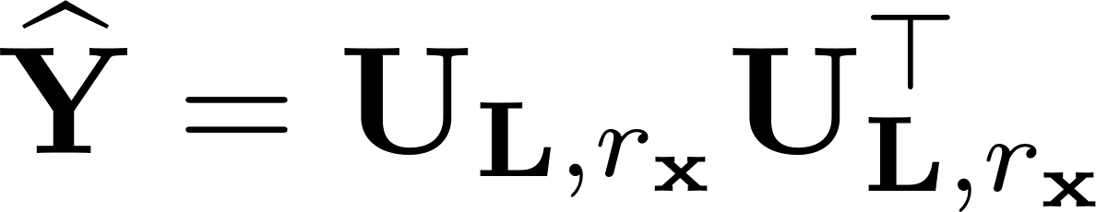



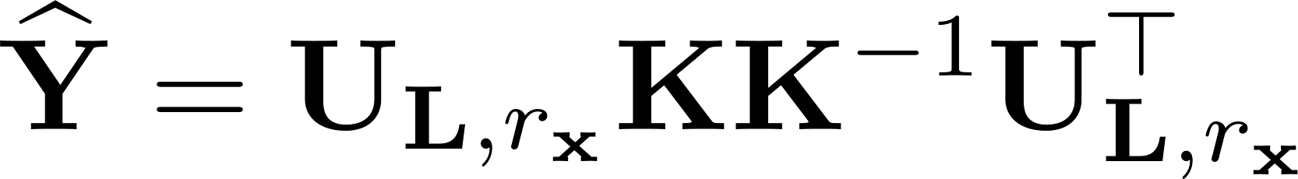
Bayes Risk Minimization Summary
The low rank solution is unique for given conditions
The decomposition of Y into E and D is not unique, since
for any invertible r_{x} x r_{x} matrix K
An optimal linear autoencoder performs the same dimensionality reduction as principal component analysis

Slide 14
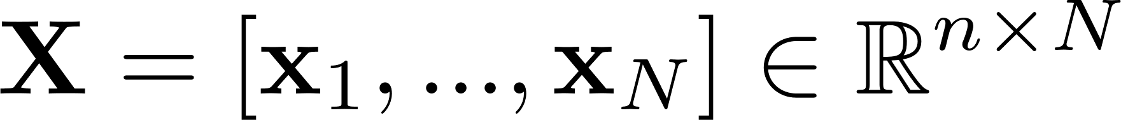
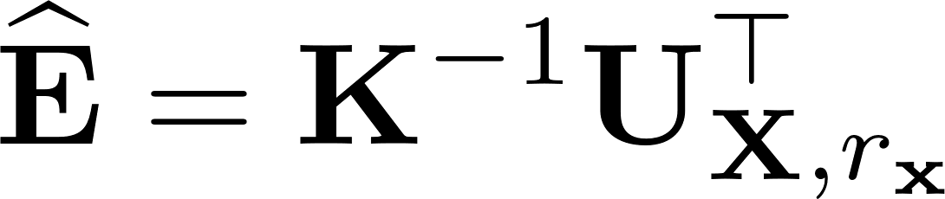
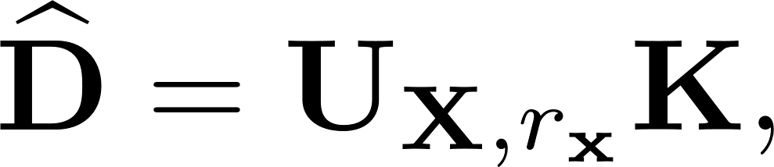
Empirical Bayes Risk Minimization
Work directly with samples of a fixed distribution
Store samples x₁, x₂, x₃, … x_{N} of X as
One optimal choice of encoder and decoder for a linear autoencoder,
yields a low rank SVD approximation of X
and

Slide 15
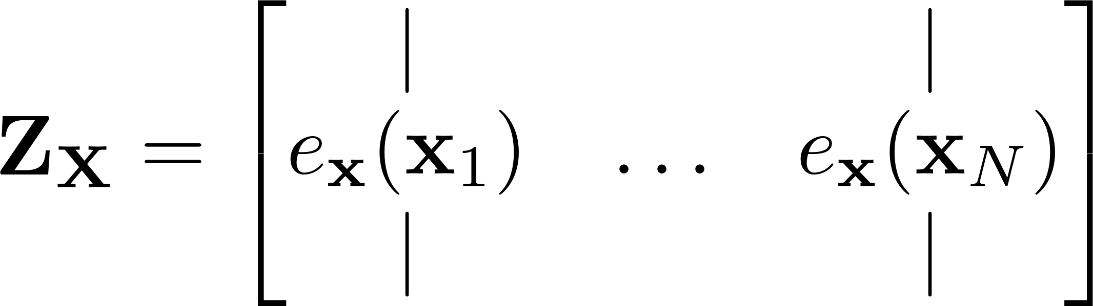
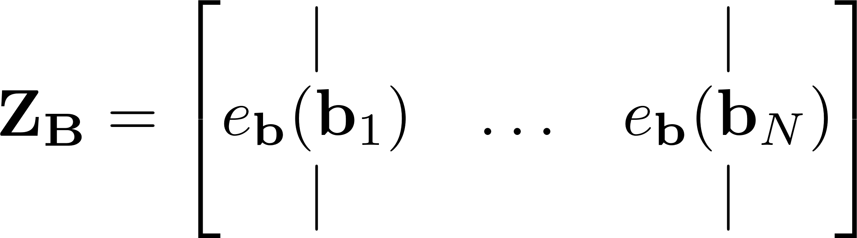
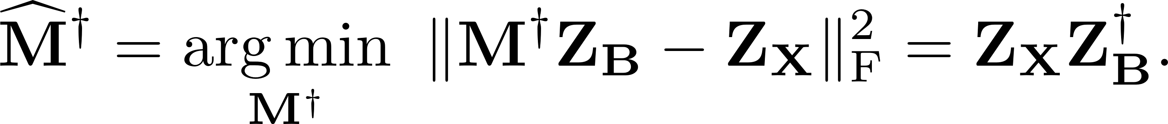
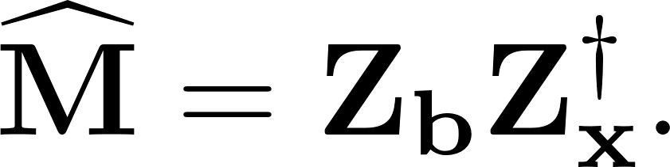
Linear Mappings between Latent Spaces
Latent Inverse Mapping: With
then, using empirical Bayes risk minimization
Latent Forward Mapping: Analogously,
and

Slide 16
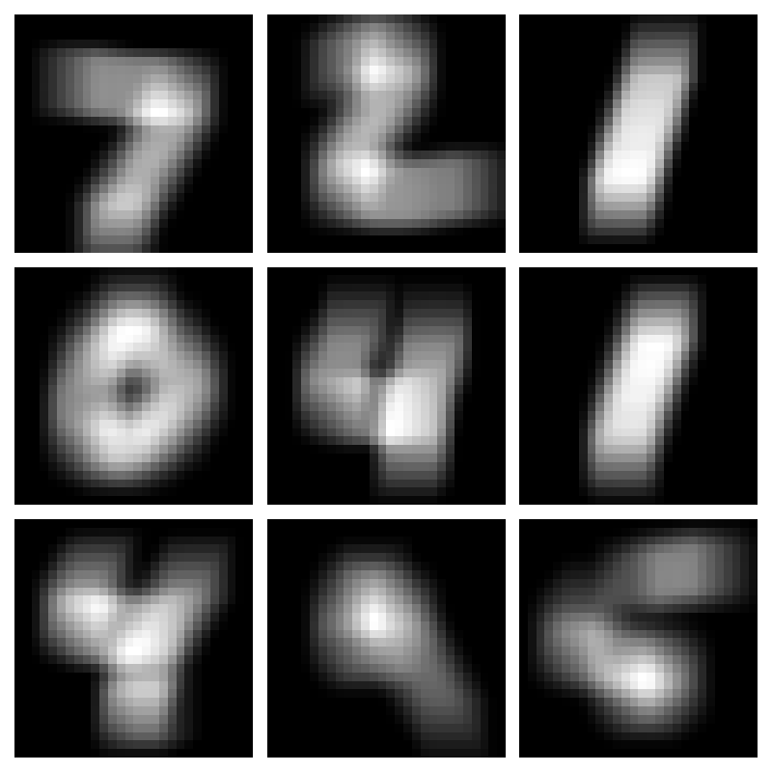
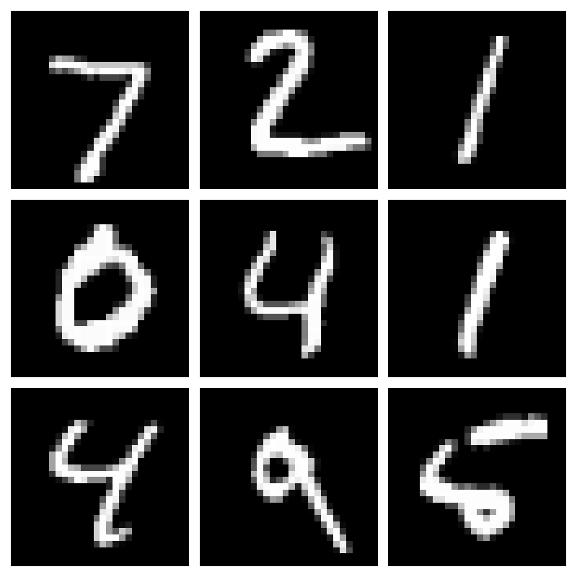


Numerical Illustrations of PAIR
Randomized Shepp-Logan Phantoms, CT Imaging
  Linear inverse problem
  Linear autoencoders, linear maps between latent spaces
  Comparisons for different size latent spaces
MNIST, Deblurring
  Linear inverse problem
  Convolutional Neural Network autoencoders, linear latent maps
  Illustrate OOD metrics
OpenFWI, Full Waveform Inversion
  Nonlinear inverse problem
  Residual Network autoencoders, linear/nonlinear latent maps
  Refine PAIR solution with latent space optimization

Slide 17
CT Example
Computed Tomography
Randomized Shepp-Logan Phantoms, Parallel Tomography

Slide 18


































CT Example: Sample Images
Input autoencoder
D_{b}E_{b}b
…
…
…
…
…
True b
True x
r_{x}
1
2
3
4
5
100
500
1000
2000
3000
Target autoencoder
D_{x}E_{x}x
…
…
…
…
…
r_{b}
1
2
3
4
5
100
500
1000
2000
3000
PAIR inverse
D_{x}M†E_{b}b
…
…
…
…
…
r_{b}=r_{x}
1
2
3
4
5
100
500
1000
2000
3000

Slide 19






CT Example: Comparison to TSVD, FBP
B autoencoder:
X autoencoder:
PAIR Inverse:
TSVD Inverse:
FBP Inverse:

Slide 20


Deblurring Example
Deblurring
MNIST, Gaussian Blur

Slide 21
Deblurring Example: PAIR Architecture
encoder e_{x}(x)
decoder d_{x}(z_{x})
z_{x}
x
x
M
M†
b
b
z_{b}
encoder e_{b}(b)
decoder d_{b}(z_{b})

Slide 22




Deblurring Example: Out of Distribution Metrics
_{Original}
_{Blurred}
_{Recovered}
_{In Distribution – MNIST}
Out of Distribution -- notMNIST

Slide 23










Deblurring Example: Out of Distribution Metrics
PAIR offers some cheaply computable metrics to help predict if a new sample is “in distribution” of training data

Slide 24
Deblurring Example: Out of Distribution Metrics
_{Original}
_{Blurred}
_{Recovered}
_{In Distribution – MNIST}
Out of Distribution -- notMNIST

Slide 25


Waveform Inversion Example
Full Waveform Inversion
OpenFWI, Acoustic Wave Equations

Slide 26




Waveform Inversion Example
When the forward model is available, we can use the learned latent spaces to refine our solution, following
True x
PAIR Initial Guess
Basic Inversion
Refined Guess

Slide 27
PAIR Conclusions and Future Work
Conclusions
Training autoencoders on inputs and targets creates a lower dimensional inverse problem between latent spaces
PAIR has theoretical connections to classical low rank SVD techniques
PAIR offers cheap out of distribution metrics and ways to refine solutions
Future Work
Uncertainty quantification with variational autoencoders
Generalization to other problems/data with exclusions

Slide 28
References
B. M. Afkham, J. Chung, and M. Chung. “Learning regularization parameters of inverse problems via deep neural networks.” In: Inverse Problems 37.10 (2021), p. 105017
S. Arridge, P. Maass, O. Öktem, and C.B. Schönlieb. “Solving inverse problems using data-driven models.” In: ActaNumerica 28 (2019), p. 1–174
Y. Bai, W. Chen, J. Chen, and W. Guo. “Deep learning methods for solving linear inverse problems: Research directions and paradigms” In: Signal Processing 177 (2020), p. 107729
Y. Boink and C. Brune. “Learned SVD: Solving inverse problems via hybrid autoencoding.” ArXiv 1912.10840
J. Chung and M. Chung. “Optimal regularized inverse matrices for inverse problems.” In: SIAM Journal on Matrix Analysis and Applications 38.2 (2017), p. 458–477
Y. Feng, Y. Chen, P. Jin, S. Feng, Y. “Auto-Linear Phenomenon in Subsurface Imaging.” In: Proceedings of the 41st International Conference on Machine Learning, PMLR 235 (2024), p.13153-13174

Slide 29
S. Friedland and A. Torokhti. “Generalized Rank-Constrained Matrix Approximations”. In: SIAM Journal on Matrix Analysis and Applications 29.2 (2007), p. 656–659
H. Goh, S. Sheriffdeen, J. Wittmer, and T. Bui-Thanh. “Solving Bayesian inverse problems via variational autoencoders.” In: Proceedings of the 2nd Mathematical and Scientific Machine Learning Conference, PMLR 145 (2021), p.386-425
K. Zeng, J. Yu, R. Wang, C. Li and D. Tao, “Coupled Deep Autoencoder for Single Image Super-Resolution.” In: IEEE Transactions on Cybernetics, 47.1 (2017), p. 27-37
K. Kulkarni, S. Lohit, P. Turaga, R. Kerviche and A. Ashok, "ReconNet: Non-Iterative Reconstruction of Images from Compressively Sensed Measurements.“ In: IEEE Conference on Computer Vision and Pattern Recognition (CVPR), Las Vegas, NV, USA (2016), pp. 449-458
S. Lan, S. Li, and B. Shahbaba. “Scaling up Bayesian Uncertainty Quantification for inverse problems using deep neural networks.” In: SIAM/ASA Journal on Uncertainty Quantification 10.4 (2022), p. 1684–1713

Slide 30
H. Li, J. Schwab, S. Antholzer, and M. Haltmeieret. “NETT: Solving inverse problems with deep neural networks.” In: Inverse Problems 36.6 (2020), p. 065005
A. Lucas, M. Iliadis, R. Molina, and A.K. Katsaggelos. “Using deep neural networks for inverse problems in imaging: Beyond analytical methods”. In: IEEE Signal Processing Magazine 35.1 (2018), p. 20–36
Y. Wu and Y. Lin. "InversionNet: An Efficient and Accurate Data-Driven Full Waveform Inversion." In: IEEE Transactions on Computational Imaging, 6 (2020), p. 419-433

Slide 31
Thank You!
This material is based upon work supported by the U.S. Department of Energy, Office of Science, Office of Advanced Scientific Computing Research, Department of Energy Computational Science Graduate Fellowship under Award Number DE-SC0024386.

